Slide 1
DB for Dive Master
Master_Info
Username (String)
Diver_Number (String)
Company (String)
First_Name (String)
Last_Name (String)
Dive_Master
Username (String)
Password (String)

Slide 2
DB for Dive Logs
Location
Location_Id (Int)
Location (String)
Dive_Site (String)
Temperature (Int)
Visibility (String)
Dive_Log
Entry_Num (Int)
Dive_Number (Int)
Date_Dive
Signature_Id
Dive_info
Entry_Num (Int)
Location_Id (Int)
Max_Depth (Int)
Bottom_Time (Int)
Safety_Coduct_Time (Int)
Tot_Time (Int)
Equipment_Id (Int)
Comment_Id (Int)
Signature
Signature_Id (Int)
First_Name (String)
Last_Name (String)
Date_Signed (String)
Dive_Number (String)
Company (String)
Dive_Equipment
Equipment_ID (Int)
Weights (Int)
Suit_Type (String)
Thickness (Int)
Air_Type (String)
Comments
Comments_Id (Int)
Comments (String)

Slide 3




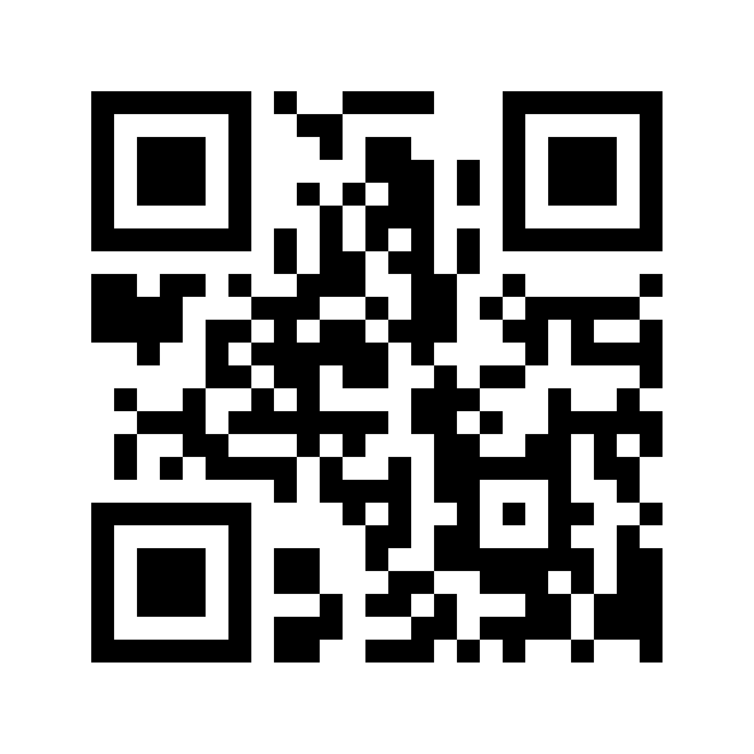
Diagram for UI flow
Log # Date Added
Dive #
Date:
Log # Date Added
Location:
Log # Date Added
Dive Site:
Log # Date Added
Temperature:
Scroll Bar
Log # Date Added
Visibility:
Max Depth:
Bottom Time:
Log # Date Added
Signed
Time Conducted Safety Stop:
Dive Master
Diver Logs
Log # Date Added
Signed
Log # Date Added
Signed
Total Time:
Air Used:
Oxygen
Nitrox
Log # Date Added
Signed
Suit:
Long
Short
mm
Log # Date Added
Signed
Weights
Kg/lb
Comments
Signature
Diver Number
First
Last
SCAN
Company
Date Signed
SAVE
SCAN

Slide 4
First Name
Username
Last Name
Password
Diver Number
Confirm Password
Company
Generate QR CODE
Next
New Account
Sign-in
Dive Master
Diver Logs
Username
Generate QR CODE
Password
Login

